Slide 1
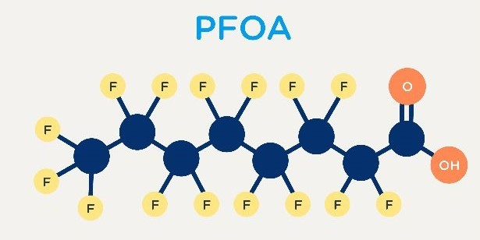
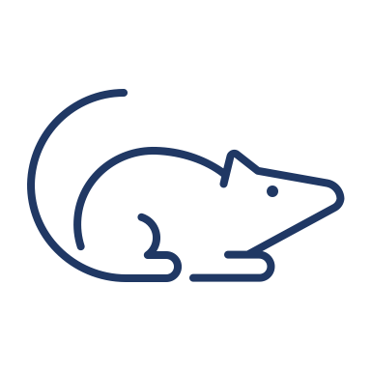



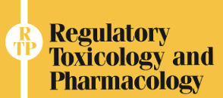
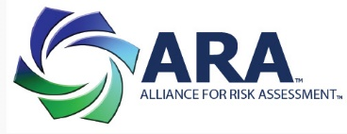
Range of the Perfluorooctanoate (PFOA) Safe Dose for Human Health: An International Collaboration
Current health-protective doses differ by >100,00-fold
Findings
Immune
Mode of Action
Liver
Developmental
0.0000015 μg/kg-day
POD, 0.94 mg/kg-day
POD, 19 μg/ml
POD, 1.0 mg/kg-day
RfD, serum 0.29 μg/ml
Most likely involves fatty acid mimicry
0.16 μg/kg-day
RfD serum, 0.25 μg/ml
RfD serum, 0.30 μg/ml
Safe dose 0.07 μg/kg-day
Safe dose 0.06 μg/kg-day
Safe dose 0.07 μg/kg-day
Methods
Epidemiology
Conclusion
3 teams, 23 scientists, 8 countries
What is known about the MOA(s) for PFOA?
What are the critical effects?
What is the range of the safe dose?
POD, 4.35 μg/ml
POD, 0.3 mg/kg-day
Range of the safe dose is 0.01 to 0.07 μg/kg-days.
Effects are of uncertain relevance to disease
RfD serum, 0.058 μg/ml
RfD serum, 0.14 μg/ml
Safe dose 0.01 μg/kg-day
Safe dose 0.03 μg/kg-day
Burgoon et al. 2023, Reg Toxicol Pharmacol.

